Slide 1
Trends ON ANIME
By WEB OF WEEB
Data Visualization - CSE3020
J component

Slide 2
THE WEEBS
20BCE1309 SANTHOSH NARAYANAN
20BCE1421 KRISHNA PRASAD Y V S PURAMA

Slide 3
What IS ANIME and ITS IMPACT
Anime is a term for a style of Japanese comic book and video cartoon animation. Anime is the prevalent style in Japanese comic books or manga . In Japan, the comic book is a popular form of entertainment for adults as well as for younger audiences.
Over the last few years, anime and manga have influenced the whole world. The characters, their style, fashion, food, culture, and art have influenced the world in a very interesting way. Be it language, martial art, songs, or food people have developed an interest in learning everything related to Japan, and its credit goes to anime.

Slide 4
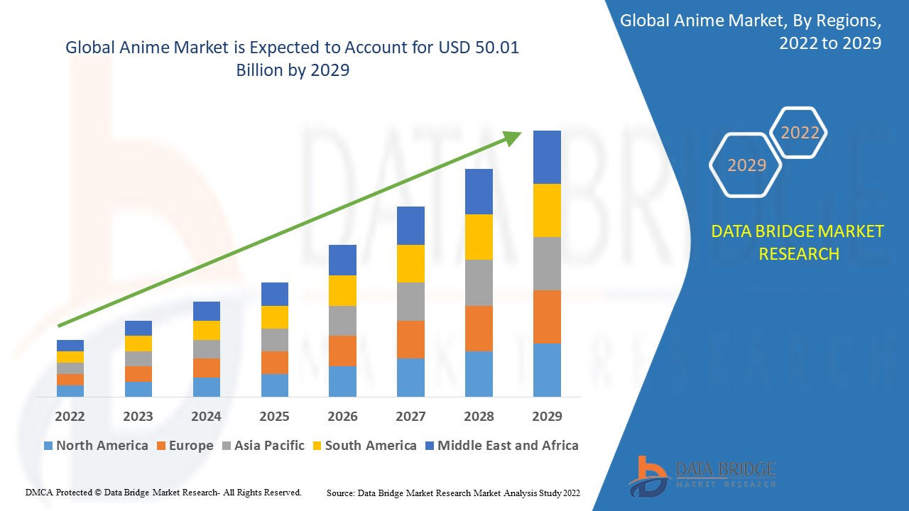
ANIME MARKET
Various factors such as the rising OTT platforms, online video sites like Youtube, several online sites, production of anime films have tremendously contributed in the growth of the anime market. The presence of various anime creators, production houses and stake holders have resulted in the high preferences for the anime shows and characters that are gaining major popularity amongst the people across the globe. Additionally, the strategic collaborations and partners have provided the market a major boost during the forecasted period.

Slide 5
THE PROJECT
The current generation is deeply influenced by anime culture. Its unique ability to grow with its viewers and the interesting and colourful depiction of human emotions has managed to play a web of deceit on the GLOBAL market. With the immense expectations and its various new works and we as weebs picture a need for a Visualization of the Growth and vastness of the culture.
In this Project we will present the various trends in this Culture.

Slide 6
DATASET
Anime Dataset
https://drive.google.com/file/d/1nQyugtovsh8zY-XzT4owWiu75egTtVMu/view?usp=sharing

Slide 7
GitHub link
https://github.com/krishnaprasad12/Anime-Commendation-System

Slide 8
Thank you

